Slide 1


EASY RENTAL
Team -17
Find your Home away from Home
Ankit Agarwal (E19CSE075)
Dharmendra Sankhla (E19CSE353)
Kaustubh Kumar (E19CSE017)
Vaibhav Sethia (E19CSE321)

Slide 2
TABLE OF CONTENTS
01
04
02
05
03
06
Introduction
Project Setup
Problems
Stakeholders
Solution
Users

Slide 3
TABLE OF CONTENTS
07
10
08
09
User Stories
Class Diagram
Use Case Diagram
Activity Diagram

Slide 4
Introduction
According to PwC, residential rental market is valued at $20 bn.
PG and hostels market growing 16-18% annually.
Need for a one-stop solution for potential tenants and property owners.
Tenants can see all the nearby properties with details at one place.
Owners can communicate with the tenant without any hassle.

Slide 5
PROBLEMS
Unfair denial of bachelors − Fear of involving in illicit activities
No Long term accommodation − Expensive housing
Dealing with Brokers − 10-15% of rent as brokerage

Slide 6
SOLUTION
Meticulously designed to focus on user demands
Choose from list of rooms based on ratings and reviews
Owners list their property provide the description, rent, feature, and images
Tenants search houses, add them to their wish list or make a booking
Host has an option to accept/decline booking
Thus, eliminating the need for a broker

Slide 7
PROJECT SETUP
Download Easy Rental repo − From https://github.com/VaibhavSethia07/Easy-Rental
Create virtual environment − In the root directory run the command pipenv shell to activate the virtual environment through command line.
Install Python, pip & pipenv −
sudo apt-get update
sudo apt-get install python3.6
sudo apt install python3-pip
pip install --user pipenv
Install Django − sudo apt install python3-django
Run the local host server − Run python manage.py runserver to run the localhost server.
Go to website − http://127.0.0.1:8000/

Slide 8
STAKEHOLDERS
01
02
03
Host
The person listing his property on Easy Rental
Tenant
The person searching for affordable housing.
Food service partner
They will be responsible for meal services.

Slide 9
USERS
Working professionals
College/coaching students
Migrant workers
Property owner

Slide 10
USER STORIES Sprint 1
ID | Description | % Completed
1 | As a tenant, I want to be able to browse through the listed properties, So that I can find the best possible room for the least amount of money | 100
2 | As a tenant, I want to add my favorite rental houses to my wish list, So that I can make a quick booking when I wish to stay | 100
3 | As a property owner, I want to upload images and details of my property, So that I can attract potential tenants. | 100
4. | As a property owner, I want to see all my listing under one section, So that I can manage all my rentals. | 100

Slide 11
USER STORIES Sprint 2
ID | Description | % Completed
1 | As a tenant, I want make online payment for rental room, So that I can confirm my booking. | 100
2 | As a tenant, I want update my profile information, So that the owner could find authentic information about me. | 100
3 | As a property owner, I want to be able to interact with potential tenants So that I can decide if they are trustworthy and suitable clients. | 100
4. | As a property owner, I want to have the accept/decline feature, So that make final decision about my property. | 100

Slide 12
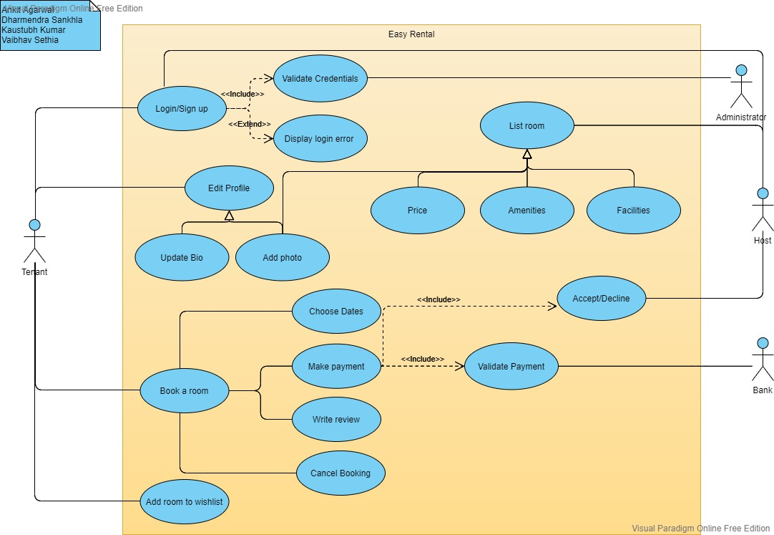
USER CASE DIAGRAM

Slide 13
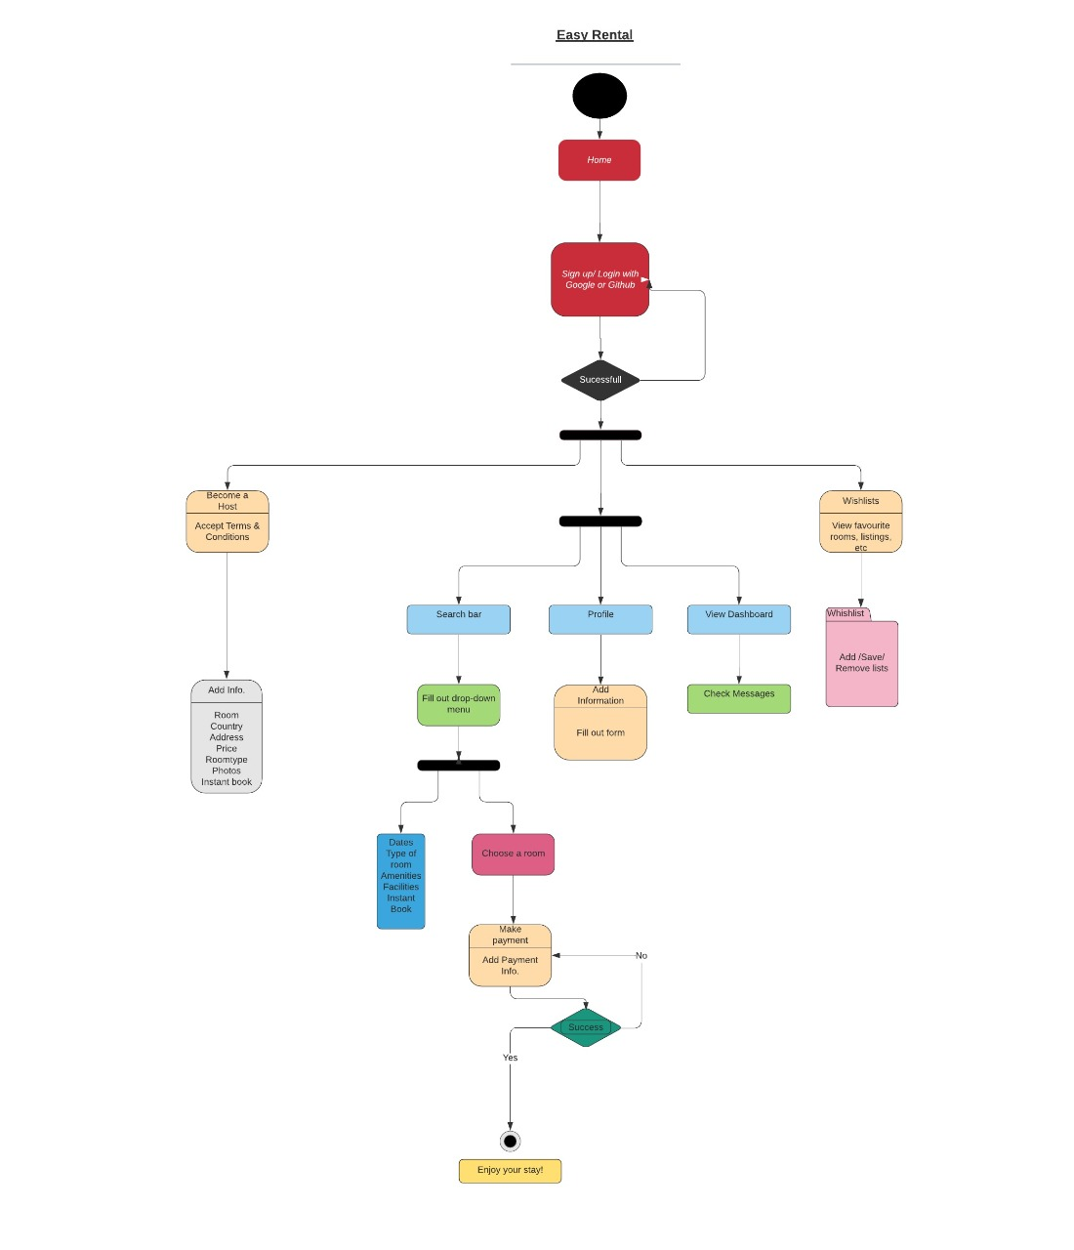
ACTIVITY DIAGRAM

Slide 14
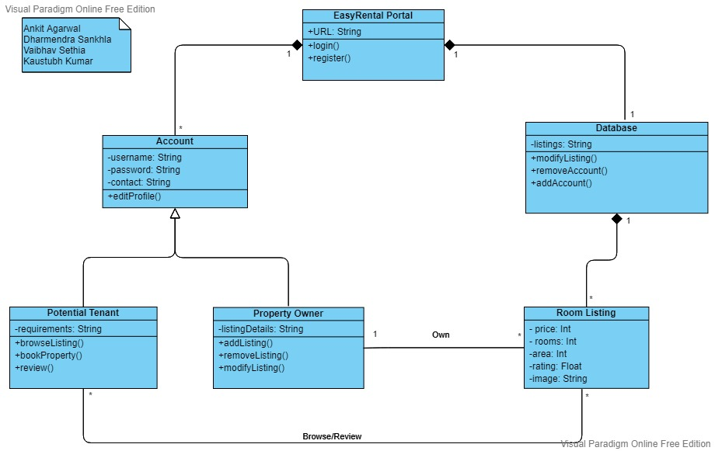
CLASS DIAGRAM

Slide 15
THANKS
Do you have any questions?
For more information
Medium
YouTube
GitHub
Please keep this slide for attribution.

